Slide 1
Spatial Concepts And Data Model

Slide 2
Geographical Space Modelling
Entity Based Model
Geographic object has two components:
a description
(2) a spatial component, also referred to as spatial object, or spatial extent, which corresponds to the shape and location of the object in the embedding space
In order to distinguish an object from others, an explicit identity is assigned to it
The interpretation of space depends on the semantics associated with the geographic territory
In practice one uses one of the following types of spatial objects:
Zero dimensional Object
One Dimensional Object
Two Dimensional Object

Slide 3
Zero Dimensional Objects or Points
Points are used for representing the location of entities whose shape is not considered as useful, or when the area is quite small with respect to the embedding space size
Cities, churches, and crossings are examples of entities whose spatial extent might be reduced to a point on a large-scale map.

Slide 4
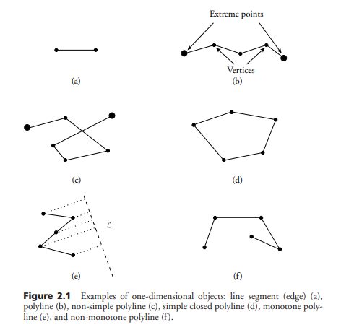
One-Dimensional Objects or Linear Objects
These objects are commonly used for representing networks
The basic geometric type is polyline.
A polyline is defined as a finite set of line segments or edges, such that each segment endpoint is shared by exactly two segments, except for two endpoints (called the extreme points), which belong to only one segment.
A polyline is closed if the two extreme points are identical.
A simple polyline is such that no pairs of nonconsecutive edges intersect at any place.
A polyline is monotone with respect to a line L if every line L orthogonal to L meets the polyline at one point at most.

Slide 5
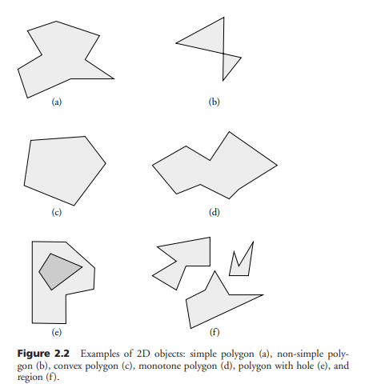
Two Dimensional Objects or Surface Objects
Used for representing entities with large areas, such as parcels or administrative units
Polygons constitute the main geometric type for such objects
A polygon is a region of the plane bounded by a closed polyline, called its boundary.
A polygon is simple if its boundary is a simple polyline.
A convex polygon P is such that for any pair of points A and B in P the segment AB is fully included in P.
A monotone polygon is a simple polygon such that its boundary δP can be split into exactly two monotone polylines M C1 and M C2.

Slide 6
Geographical Space Modelling
2. Field Based Model
In a field-based (or space-based) approach, with each point in space is associated one or several attribute values, defined as continuous functions in x and y.
The altitude above sea level is an example of function defined over x and y, whose result is the value of a variable h for any point in the 2D space
The measures for several phenomena can be collected as attribute values varying with the location in the plane
This view of space as a continuous field is in contrast with the entity-based model, which identifies a set of points (region, line) as an entity or object.
The concept of object is not relevant in the field-based approach

Slide 7
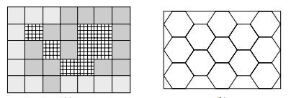
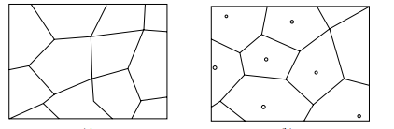
Representation Modes
Tessellation
A cellular decomposition of the plane (usually, a grid) serves as a basis for representing the geometry
The partitioning of the embedding space into disjoint cells defines a discrete model, sometimes called spatial resolution model, tiling, or meshes in the field of computer graphics.
Can be further divided into fixed (or regular) and variable (or irregular) tessellation modes.
A fixed representation model uses a regular grid or raster, which is a collection of polygonal units of equal size.
A variable spatial resolution model handles units of decomposition of various sizes
The size of the units may also change according to the level of resolution
Regular Tessellation
Irregular Tessellation

Slide 8
Field Based Data in Tessellation Mode
A regular tessellation may be encountered in applications that process image data coming from remote sensing (satellite images), such as weather or pollution forecast
Then field-based data is still represented as a function from space to a range such as temperature or elevation
space is no longer seen as a continuous field, but as a discrete one, which permits an explicit representation of data
An irregular tessellation is used, for instance, in zoning (a typical GIS function) in social, demographic, or economic data
Other applications include surface modeling using triangles or administrative and political units

Slide 9
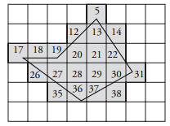
Entity Based Data in Tessellation Mode
A spatial object in 2D space is represented by the smallest (finite) subset of pixels that contains it.
A point is described as a single pixel.
Its location is described as the pixel address; that is, a pair of integer coordinates
A polyline, polygon, or region is represented by a finite number of pixels
In Figure the following list of pixels is a representation of polygon P.
< 5, 12, 13, 14, 17, 18, 19, 20, 21, 22, 26, 27, 28, 29, 30, 31, 35, 36, 37, 38 >
For the sake of simplicity, instead of using the (x,y) coordinate notation we referenced cells by an integer identifier.

Slide 10
Tessellation Mode
The tessellation mode makes it possible to approximate a spatial object by a finite number of cells.
The larger the grid resolution (i.e., the smaller the pixel size), the better the approximation but the higher the number of cells for representing an object.
A faithful object representation has as a consequence that objects occupy much memory space.
In addition, operations on objects are then more time consuming. This is a clear drawback to this approach.
Nevertheless, information may sometimes be compressed to lead to a more compact form.
The tessellation mode is of prime importance because of the exponentially growing volume of data coming from satellite (raster) sources and because of the increasing use of it in specific applications, such as environmental fields (pollution, weather etc)
Most of the analysis, storing, and querying in many applications (and hence in commercial GIS) is made on spatial data stored under vector format,

Slide 11
Vector Mode
In vector mode, objects are constructed from points and edges as primitives
A point is represented by its pair of coordinates, whereas more complex linear and surfacic objects are represented by structures (lists, sets, arrays) on the point representation.
In contrast to a raster representation, a vector representation is not eager in memory.
In particular, a polygon is represented by the finite set of its vertices

Slide 12
Entity Based Data In Vector Mode
There exists a large number of variants to represent polylines and regions in a vector mode.
The following is a simple representation.
A polyline is represented by a list of points < p1,... pn >, each pi being a vertex. Each pair (pi, pi+1), with i < n, represents one of the polyline’s edges.
A polygon is also represented as a list of points. The notable difference is that the list represents a closed polyline, and therefore the pair (pn, p1) is also an edge of the polygon.
A region is simply a set of polygons.
point : [x: real, y: real]
polyline : < point >
polygon : < point >
region : { polygon }
a polygon with n vertices has 2n possible representations.
There are n ways of choosing where to start the boundary description; once the starting vertex has been chosen, there are two ways of scanning the vertices, called clockwise and counterclockwise orders

Slide 13
Entity Based Data In Vector Mode
There is no apparent distinction between a polyline structure and a polygon structure.
It is up to the software that manipulates geometric data to interpret properly the structure, and to check that the representation is valid; that is, to verify that the polyline is closed for the polygon
This remark holds for other possible constraints on the polygon type, such as convexity.
Neither can we guarantee that a polygon is simple, in that the foregoing data structure does not prevent two nonconsecutive edges to intersect.
The structure is unfortunately not powerful enough to ensure the correctness of the representation

Slide 14
Field Based Data In Vector Mode
DEMs provide a digital (and thereby finite) representation of an abstract modeling of space.
Although the term elevation refers to the altitude above sea level, DEMs are useful to represent any natural phenomenon that is a continuous function of the 2D space (e.g., temperature, pressure, moisture, or slope).
the function of x and y is not represented at all points in 2D space
DEMs are generally based on a finite collection of sample values, from which values at other points are obtained by interpolation.
There are various ways to define the interpolation, which mostly depend on the sampling policy.
Among them, Triangulated Irregular Networks (TINs) are widely used.
A TIN is based on a triangular partition of 2D space.
No assumption is made on the distribution and location of the vertices of the triangles.
The elevation value is recorded at each vertex, and inferred at any other point P by linear interpolation of the three vertices of the triangle that contains P
Data structures for TINs require an intensive use of pointers. Apart from the set of sample points P, a set V of edges and a set T of triangles need to be stored

